Slide 1
MCH
Core Standards – working together to develop skills for learning and living.

Slide 2
MCH support
Speech and language
ADHD
ASD
OT
Podiatry
School nursing team – sleep/eating/asthma/continence
Physiotherapy
Audiology

Slide 3
How do we access this?
Online referrals
Through school nursing team
Traded service support (OT/SALT)
GP

Slide 4
Referrals
All referrals now need to be evidence based
All referrals have an expectation that home and school have worked together
All referrals have specific things that already need to have happened

Slide 5


The iceberg effect
Literacy difficulties, behaviour difficulties, speech difficulties – tip of iceberg – the underneath is language & communication difficulties.

Slide 6
Difficulties in sitting still and concentrating (ADHD)
There is an expectation that reasons for this referral have been explored and the parent has met with your school’s special educational needs coordinator to discuss strategies to be tried prior to this referral.
In addition we do expect parents to have been offered an evidenced based parenting programme such Triple P or Parent Awareness Session and/or to have had public health support e.g. referral to Health Visiting (up to 7 years) or School nursing services prior to the referral being accepted.
This does not include sudden changes in children who previously did not present with these difficulties.
Currently 60/40 diagnostic rate

Slide 7
Indigo Social Communication Pathway referrals (Autism)
They must have difficulty around all of the following areas:
Reciprocal social interaction
Repetitive and stereotyped behaviours
Showing sensory sensitivities - We do not see children who only present with anxiety and who require behavioural management - We do not see children that only have sensory needs
For children with additional sensory needs child must have completed 2 terms of hopscotch, BEAM, fizzy, sensory circuits or similar
The school must have social communication friendly strategy in place
The school should seek advice from the school nurse or health visitor before making this referral Parents

Slide 8
Sensory difficulties
The way the body interprets sensory information is called sensory processing.
We have the ability to take in, sort out, process and make information from the world around us.
The responses include:
Movement responses
Emotional responses
Behavioural responses
Social responses
Ability to concentrate

Slide 9
Senses
Touch
Sight
Sound
Smell
Taste
Vestibular – sense movement
Proprioception – sense body positon

Slide 10
Sensory Processing difficulties
Over responsive
Under responsive
Sensory seekers
Over – avoids messy play/reluctant to was/alarmed by loud noises/likes soft & bland food/notices smells/over anxious/dislikes PE/tiptoes/press too hard/hold pencil too tight/
Under – passive/doesn’t react to changes/doesn’t hear their name/’floppy’/lethargic/forgetful/can be solitary/toilet issues/tiptoes/spidery writing
Seekers – fidgets/flaps/rocks/loves strong smells & tastes/can be loud/ climbs, jumps, touches, runs/chews/interrupts/hand bang/bites

Slide 11
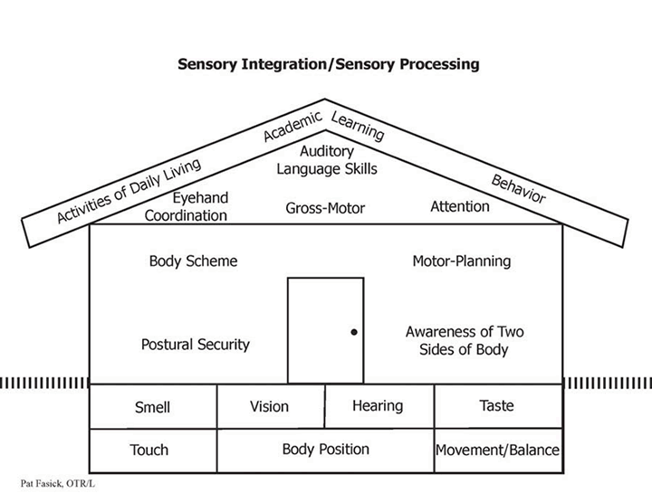
Why is sensory so important?

Slide 12
Sensory circuits/support
Over – self-joint compressions/chair & wall press/firm pressure touches/give warnings/visual timetables/timers/quiet time/calming strategies/headphones
Under – wobble cushions/weighted lap cushions/vibrating cushions & pens/textured items/putty/hand massages/movement breaks/heavy work/regular exercises
Seekers – movement breaks/self-compression/heavy work/move & sit cushion/work station/ avoid over stimulation

Slide 13
Postural stability and balance issues
Two activities to test this:
Superman
Hedgehog
Strengthening activities = crab walking/bridge/plank/scooter boards
Balancing activities = tightrope walking/stomp walking/scooters/pop bubbles with your toes/beanbag & ball work
Co-ordination is the coming together posture, balance and movement. This also needs practice.

Slide 14
Integration
Bi-lateral integration – activities where right & left side of body are required to perform differently (buttons/shoes laces/eating)
Support by - marching/spotty dogs/left & right touch activities/clapping games/tapping activities
Visual motor integration – the ability to combine what is seen with fine motor control
Support by – pattern drawing/sewing & weaving/mazes/tracing/wordsearches/spot the difference/Where’s Wally

Slide 15
Hand Strength & stability
Finger wrestling
Flicking
Tweezer pick up games
Elastic band weaving
Card games including shuffling
Pencil pick up
Finger lift
Finger football
Tents
Pick up games (coins)
Hand exercise – dinosaur/slug/spider

Slide 16
Challenging Behaviour
“Severely challenging behaviour is behaviour of such intensity, frequency or duration that the physical safety of the person or others is placed in serious jeopardy, or behaviour which is likely to seriously limit or deny access to the use of ordinary community facilities.”
Emerson 2001

Slide 17
Behaviour is a form of communication – the person will be trying to tell us something.
We can be pro-active or reactive when tackling behaviour:
Pro-active - Provide sensory input/reward positives/give just the right challenge/avoid lots of choices/clear instructions/reward systems/calm approach/use countdown/avoid attention/avoid no/use first & then
Reactive – about safety/use diversion

Slide 18
5 main types of behaviour function
Avoidance/escape
Obtaining a tangible object
Attention seeking
Sensory avoidance or seeking
Pain

Slide 19
Communication
5 areas of communication –
attention & listening (not the same)
Understanding spoken language
Using spoken language
Speech sounds
Social interaction

Slide 20
What is communication?
Attention & listening – hearing, listening, attending
Comprehension – receiving, understanding, making sense (includes non-verbal)
Expression – conveying a message
Speech - making & sequencing sound to make words
Social skills
Thinking skills – reasoning, prediction, inference, deduction, causality
All part of the same jigsaw

Slide 21
Speech – production of individual sounds and blending sounds to form words
Language – use of words and understanding of words (expressive & receptive)
Communication – conveying thoughts, needs, wants & ideas (includes non-verbal)
Non –verbal – clues from environment/voice/body/eyes/gesture/facial – 70% of our language is this

Slide 22
Just to be able to say a sentence we need to…
Attend & look
Concentrate & listen
Info then enters ear
Memory has to engage
Have to understand
Decide what you want to say
Pick relevant words
Place words in correct order
Choose correct sounds
Use articulation

Slide 23
Appropriate Attention & Listening Development
By 5/6 years there should be integrated attention – able to carry out a task and listen to an adult.
The stages prior to that are –
Fleeting attention (0 -1yrs)
Rigid attention (0-1yrs)
Single channelled attention (1 – 2yrs)
Single channelled with flexibility (2-3yrs)
Attention under voluntary control (3 – 4yrs)
Two channelled attention (4-5yrs)
Integrated attention (5-6yrs)

Slide 24
How can we help to improve listening & attention?
Get down to a child’s level
Teach them what good listening looks like
Use their name as a cue in
Reduce language used – fewer words
Use wait cards or timers to improve attention
Focus and re-focus attention
Use hand gestures
Use repeat back
Teach turn taking

Slide 25
Typical Receptive Language development (comprehension)
1 yr – understands ‘give me the teddy’- 1 key word
1.6yrs – should have 250 everyday words
2yrs – understands ‘put the teddy in the box’ – 2 key words
2.5yrs – understand ‘put socks in the drawer’/prepositions/simple instructions – 3 key words
3yrs – questions/pronouns/size
4yrs – can follow 2 part instructions/simple questions/colours
We do not need to understand every word to follow

Slide 26
Typical Expressive Language(using spoken language)development
1.5yrs – 50 words
2yrs – joining 2 words together/ uses own name/100 – 300 words
2.5yrs – using 3 word phrases/plurals/past tense
3yrs – 4 -5 word phrases/questions/1000 words/rhymes/describes experiences
4yrs – link ideas together – but/5-8 word sentences/pronouns/more questions

Slide 27
How can we help?
Multisensory approach – draw out/act out words
Repeat new words
Use words in different situations
Play word games
Keep a word dictionary
Mind maps
Vocab boxes
Share stories
Audiobooks

Slide 28
Speech sound production
1 – 2yrs – p/n/w/h/b/m
2 – 3 yrs – t/d/g/f/k/ing/y
4+yrs – z/v/ch/s/l/j/sh
We need to – model/acknowledge attempts/use nursery rhymes/face to face when talking/slow down your speech/avoid over-correcting/listening games/mirror work/read/target games eg. Eye spy

Slide 29
Memory
STM – info from senses/make sense of info given/only lasts 20secs
WM – moves info from ST to LT
LTM – holds our knowledge of the world/ constantly updated/needs organising
How we remember – doing it/hearing it/seeing it – need all things
Memory Games - ideas

Slide 30
Social skills & Play Development
1yr- solitary/exploratory play/shouts/makes demands/uses eye contact
18mths – parallel play play/shouts/makes demands/uses eye contact
2yrs – early conversations/oppositional/tantrums/humour/understands gesture
3yrs – recognises anger, joy/displays strong emotions/obeys simple rules/can be physically aggressive/uses other people’s names//co-operative play/role play
4yrs – expresses own feelings/social greetings/gives orders/start conversations/likes to share/co-operative play/imaginary friends

Slide 31
How can we help with social development?
Structure
Be predictable
Be consistent
Be visual
Rule based games
Social stories
Praise strengths
All this will support independence as well.

Slide 32
NOTE – World Health Organisation!
WHO – through research they have concluded that there should be no screen time before 3yrs of age, need 2/3hrs of exercise – otherwise children will potentially experience developmental issues of those described throughout this presentation
Films/TV nowadays have increased movement and decreased plot as filmmakers are aware this is how children are in today’s society

Slide 33
So what?
Slides will be placed on our website
Helpful handouts are at back
We are always available for further information
Our traded services teams can help us all
Look out for training and support bookable through MCH website
Let’s work together in the build up to referrals

