Slide 1

Welcome to the SEND coffee meet up for St. Margaret’s Infant and Junior Schools.

Slide 2

Aims of the Session
• What is stress and anxiety?
• What triggers stress and anxiety?
• How to notice someone is Anxious?
• Understanding the physiology of the brain when
anxiety is triggered?
• 8 ways a child’s anxiety shows up as something else

Slide 3
Anxiety is normal.
It is the basis of Survival because it prepares our bodies to cope with danger.
In moderate amounts it helps to improve our performance

Slide 4
What is Anxiety?
Type of fear or strong feeling about a situation
Thought of a threat or something which may go wrong in the future
Causes fright and uncertainty
Lasts a short time or can be prolonged
Can affect our ability to eat, sleep, concentrate, travel, leave the house, go to school and work
Can interfere with our enjoyment, take over our lives and even control our thoughts and behaviours

Slide 5
What Triggers Anxiety?
After something bad has happened
Significant life events such as bereavement/ illness/ separation or bullying
Fears: Dogs, spiders, snakes, flying, wasps
Genetic predisposition – how we are made up
Temperamental disposition – how we behave
Uncertainty– A fear of having to do something new or out of our comfort zone.

Slide 6
Physical Signs of Anxiety
• Fast / irregular heart beat
• Increased breathing rate / shallow breathing
• Dry mouth or throat
• Weak/ tense /tingling/aching of muscles
• Feeling lightheaded /headaches/dizziness
• Stomach aches or bowel problems
• Sweating – hot and cold
• “Frozen” to the spot
• Blurred vision
• Sensory Seeking Behaviours

Slide 7
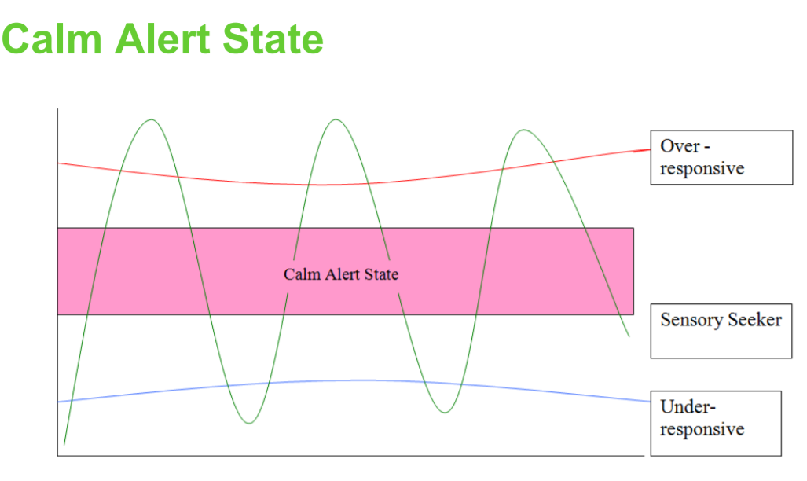

Slide 8
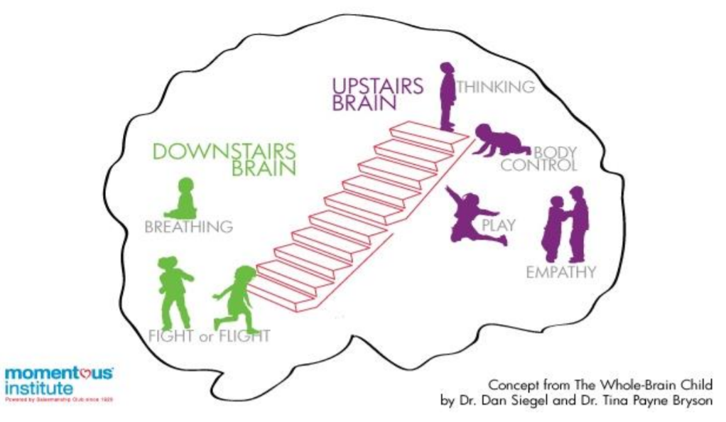

Slide 9
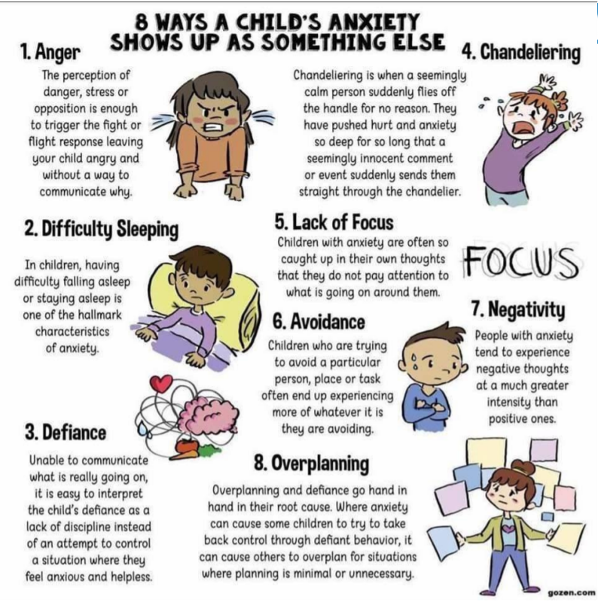

Slide 10
What is behaviour?
• Behaviour is everything we do – our actions,
thoughts and things we say.
• It’s a response to stimulus
• All behaviour occurs in an environmental context
• All behaviour (apart from reflex) is learned
• Behaviour is observable (seen and heard) and
measurable (counted or timed)

Slide 11
What is learning theory?
• Behaviour is learnt.
• If a behaviour can be learnt, it can be unlearnt.
• Behaviours that make us feel good or get us what
we want will be repeated (reinforced).
• Negative or Positive reinforcement will strengthen
a behaviour.

Slide 12
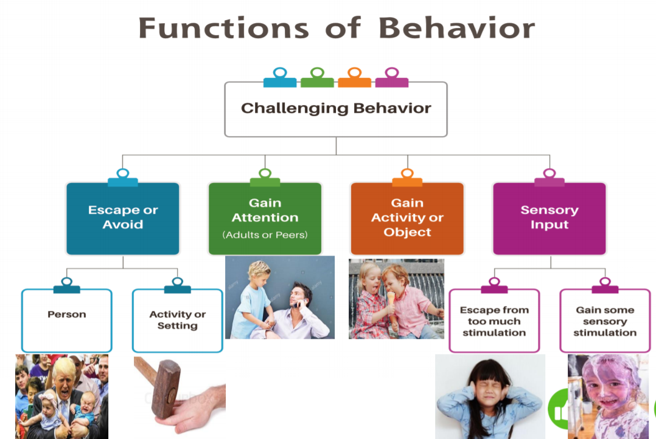

Slide 13
Form and Function of Behaviour
• Form…
…is what the behaviour looks or sounds like
• Function…
…is its purpose, that is, what it helps the person achieve.

Slide 14
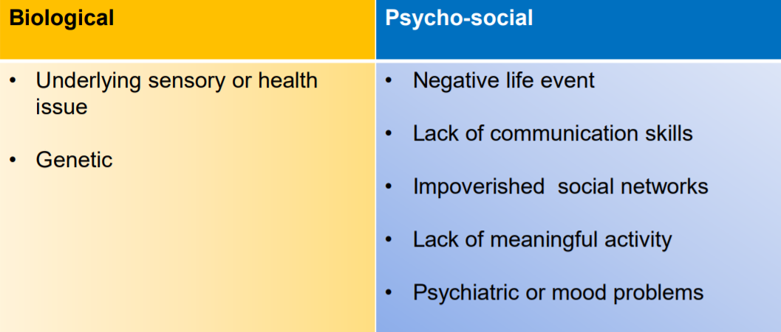
Why behaviours of concern may occur

Slide 15
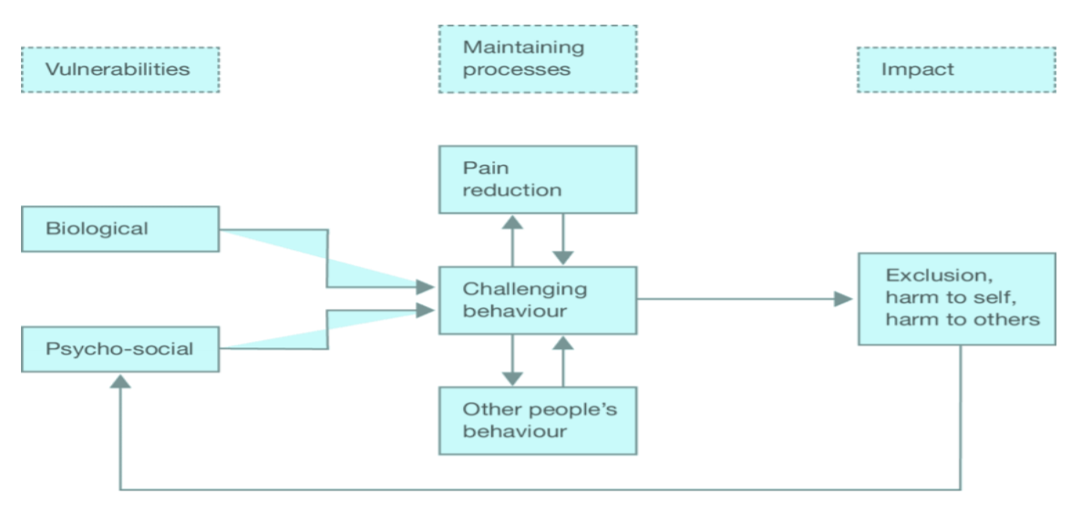
Framework for why behaviours occur

Slide 16
D.A.S.H.
• Define the behaviour in an observable and
measurable way
• Ask people who know the person well about
the behaviour
• See the behaviour through observation of the
person
• Hypothesise where, when and why the
observation occurs- what is its function?

Slide 17
How can we Help?
• Encourage children to talk about how their body
feels when they experience different types of
feelings
• Share examples of your own body clues.
▪ Happy
▪ Sad
▪ Angry
▪ Worried

Slide 18
Sharing Feelings
• Encourage children to talk about things that upset them including any fears or worries.
• Share some of your own childhood worries and
fears. This will help children understand that
feeling anxious and worried is normal and okay.
We all feel this way sometimes – even adults!

Slide 19
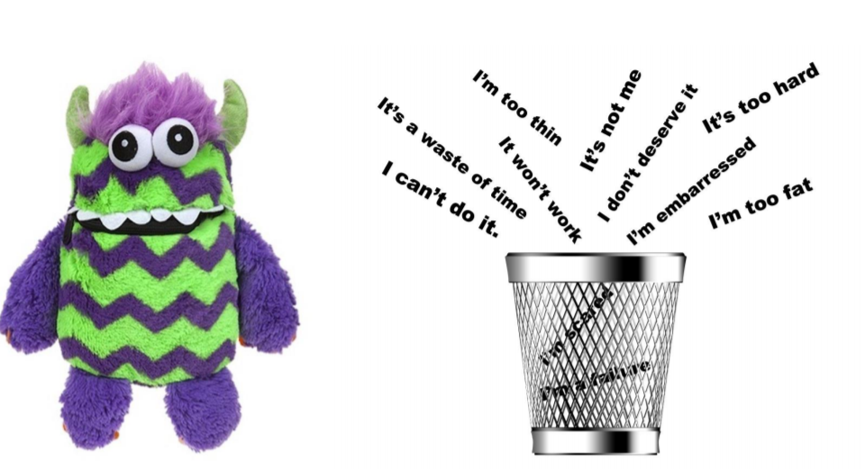
Worry Monster or Rubbish Thoughts Bin

Slide 20
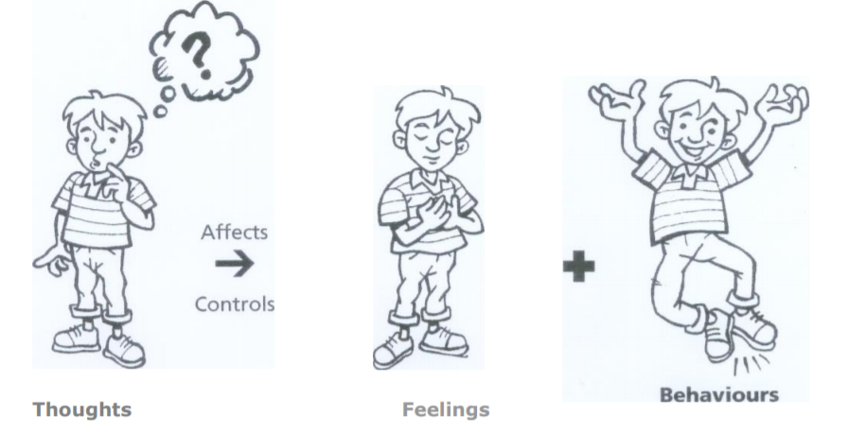
Inner Thoughts…
The way we THINK influences the way we FEEL and BEHAVE

Slide 21
Tips for influencing positive thoughts
• Encourage children to focus on the positives of situations and not the negatives.
• Help children become aware of their self-talk and assist them in turning negative thoughts into positive and powerful thoughts.
• Help children practice replacing unhelpful thoughts with more positive thoughts.
• Young people model what they see and hear around them. If you recognise that you are saying unhelpful words or feeling tense or nervous then let children know that you are aware of this. Then demonstrate coming up with an alternative positive way of looking at your situation.
• We should model our own success to help children acknowledge their own success. Its ok to be proud of your achievements.

Slide 22
SELF-ESTEEM
• A huge confidence boost for children is to give them
lots of praise for their attempts at difficult
activities.
• Reward children when they try their best e.g. if
they try something they have never tried before or
if they do something that they usually find a bit
scary. Tell them that they should feel proud of
themselves!

Slide 23
SELF-ESTEEM
• Recognise partial successes (not just for reaching their
final goal). This helps children to learn to persist and not
give up when things get difficult (learning to focus on
small, achievable steps).
• Encourage children to feel good about themselves when
they have done their best, even if things do not go as
planned. E.g. if a child does something new/faces a fear,
they could say to themselves …
“I am a winner because I tried my best and I know what to
do next time”.

Slide 24
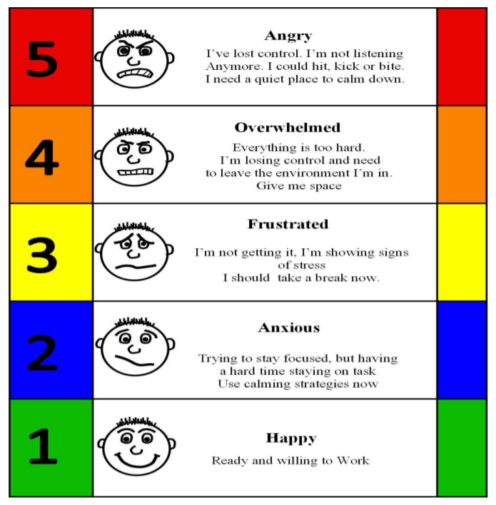
The Incredible 5 point scale

Slide 25
Invest in Down Time
Engaging in relaxation strategies helps to reduce anxious feelings and to remain in control.

Slide 26


Some useful books …

Slide 27
Sources of Help for Schools and/or Parents
• The Children and Young People's Mental Health Service (CYPMHS) Online self-help resources at MindFresh here:
https://mindfresh.nelft.nhs.uk/ or call 0300 123 4496 to self-refer.
• Association for Child Psychology and Psychiarty: 020 7403 7458
• Parentline: 01702 554782+
• Exploring Parenthood: 020 7221 6681
• Mind Info line: 08457 660163
• Young Minds 0800 018 2138
Children can also contact childline which is a confidential helpline. Childline: 0800 1111

